Slide 1
Energy Options From Pacific Power
Blue Sky Blocks
$1.95/100kwh (typical home uses 500-1000kwh/mo)
Energy Source: 100% Wind.
Blue Sky Usage:
$0.0078/kwh (about 10%) above “regular” energy cost.
Energy Source: Wind 61%; Biomass 38%; Solar 1%
Habitat:
Rate the same as “Blue Sky Usage”
Energy Source: Wind 61%; Biomass 38%; Solar 1%
Additional ‘donation’ $2.50/month to The Nature Conservancy for restoration of native salmon habitat.

Slide 2
Get Help With Energy Consumption
Energy Trust of Oregon: Click here for Website
Help: Free home energy audit.
Cash rebates for solar water heating; Solar electric panels, more energy efficient heating
State of Oregon Help:
Tax credits to buy energy efficient appliances, solar electric panels and other things.
Click here for Energy Tax Credits
Local Electric Utility Help:
Electricity rebates and others for Energy Star purchases (and others—always check)

Slide 3
Donald Trump in “Windmills”

Slide 4
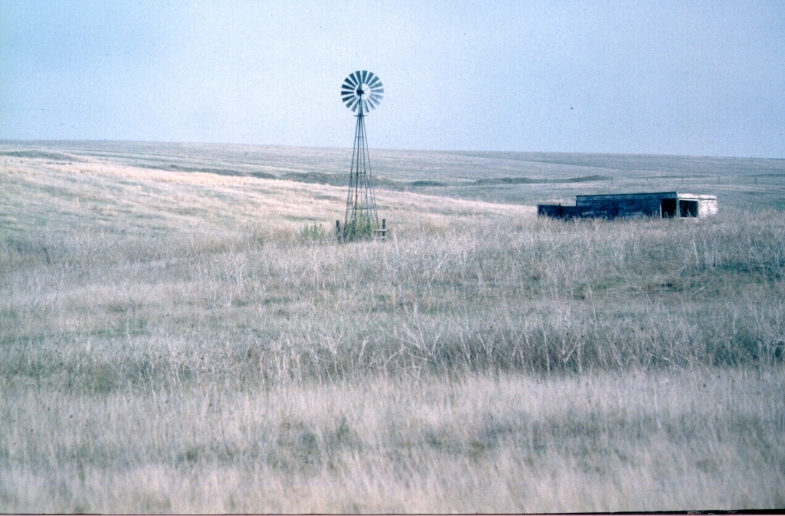
Wind Power

Slide 5
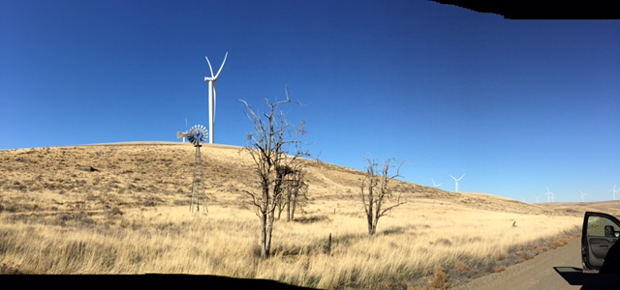
And out in our very own Gillam County*
Thanks to Gillam County student, Mary Rietmann for this photo

Slide 6
Why Wind Power?
Is Wind Power Competitive?
US Dept. of Energy “Levelized Costs of new generation facilities in 2022”
Hydropower 8.5 cents/kwh
New Wind 8.0 cents/kwh
New Coal 11 cents/kwh
New Natural Gas 6 cents/kwh
New Solar PV 2 cents/kwh
New Geothermal 4.8 cents/kwh
New Nuclear far above all others

Slide 7
Wind Power Advantages
Reduced Dependence on Fossil Fuel

Slide 8
Wind Power Advantages
Reduced Dependence on Fossil Fuel
It is perpetual
As long as the wind blows, you have energy inputs

Slide 9
Wind Power Advantages
Reduced Dependence on Fossil Fuel
It is perpetual
Wind speed increases during day as demand increases.

Slide 10
Wind Power Advantages
Reduced dependence on fossil fuel
It is perpetual
Wind speed increases during day as demand increases
Turbines inexpensive and quick to install
2MW models cost about $2.5 million
Often less than a year from permit application to operating wind farm.

Slide 11
Wind Power Advantages
Reduced dependence on fossil fuel
It is perpetual
Wind speed increases during day as demand increases
Turbines inexpensive and quick to install
Reduced Environmental Impacts
At least the operations. There are no free lunches—it takes resources to make these things and recycling at the end of their life.

Slide 12
Wind Power Advantages
Reduced dependence on fossil fuel
It is perpetual
Turbines inexpensive and quick to install
Reduced environmental impacts
Price stability
The wind is “free” it costs the same this year as the next, and the next, and the next.

Slide 13
Wind Power Advantages (con’t)
More jobs per unit of energy

Slide 14
Wind Power Advantages (con’t)
More jobs per unit of energy
Long-term income to ranchers and farmers

Slide 15
Wind Power Disadvantages
Wind must blow 2/3rds of the time

Slide 16
Wind Power Disadvantages
Wind must blow 2/3rds of the time
Need 15-18 mph constant wind

Slide 17
Wind Power Disadvantages
Wind must blow 2/3rds of the time
Need 15-18 mph constant wind
Often requires new infrastructure (power lines)

Slide 18
Wind Power Disadvantages
Wind must blow 2/3rds of the time
Need 15-18 mph constant wind
Often requires new infrastructure (powerlines)
Chops birds and bats

Slide 19
Wind Power Disadvantages
Wind must blow 2/3rds of the time
Need 15-18 mph constant wind
Often requires new infrastructure (powerlines)
Chops birds
Noisy

Slide 20
Wind Power Disadvantages
Wind must blow 2/3rds of the time
Need 15-18 mph constant wind
Chops birds
Often requires new infrastructure (powerlines)
Noisy
Sight Pollution (all towers must have blinking lights)

Slide 21
Wind Power Disadvantages
Wind must blow 2/3rds of the time
Need 15-18 mph constant wind
Chops birds
Often requires new infrastructure (powerlines)
Noisy
Sight Pollution (all towers must have blinking lights)
Ugly?? Maybe more Surreal

Slide 22
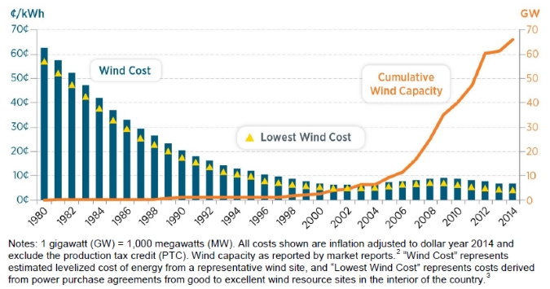
US Land Based Wind Installations 1980-2015

Slide 23
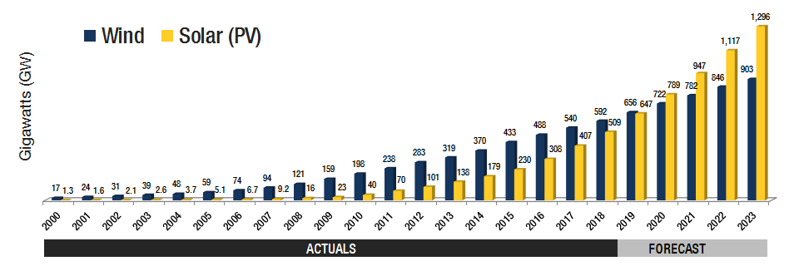
Global Wind & Solar Installation

Slide 24
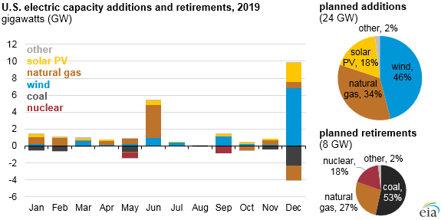

Slide 25
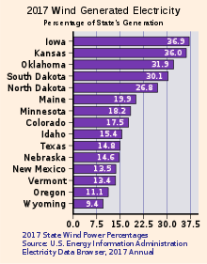

Slide 26
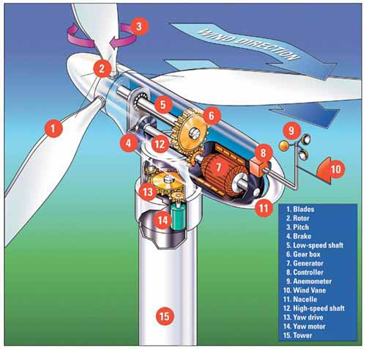
How a Wind Turbine Works

Slide 27
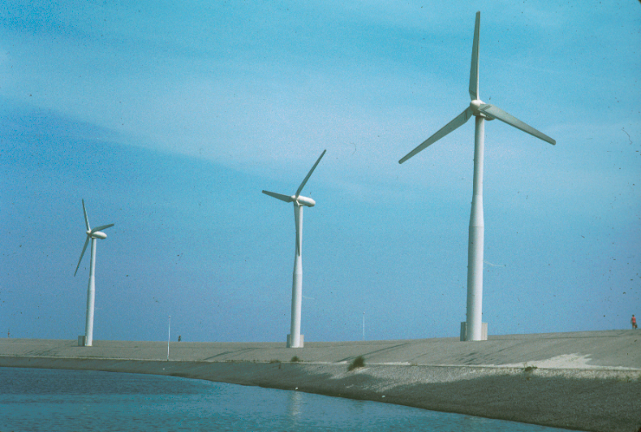
The Netherlands, 1992

Slide 28
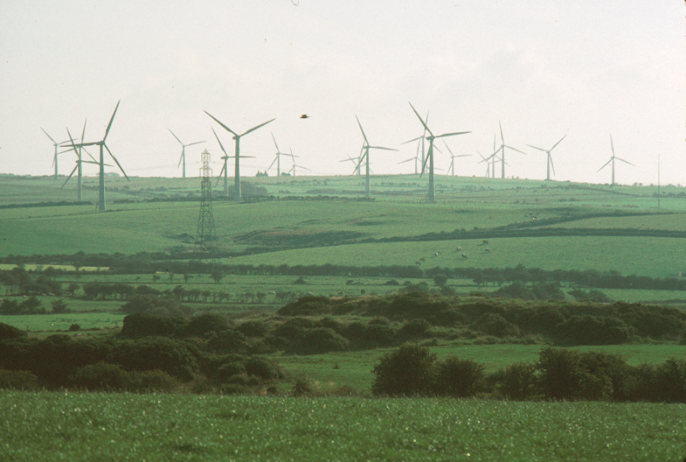
Anglesey, Wales, 2003

Slide 29
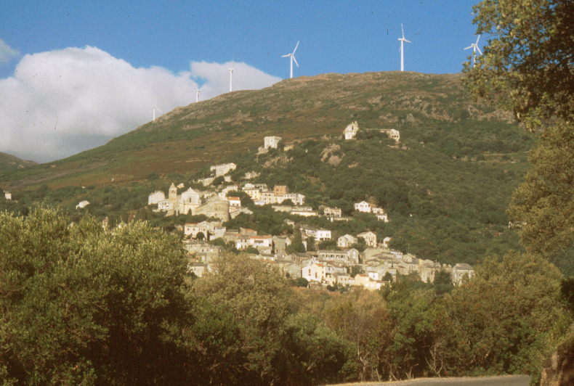
Corsica, 2005

Slide 30
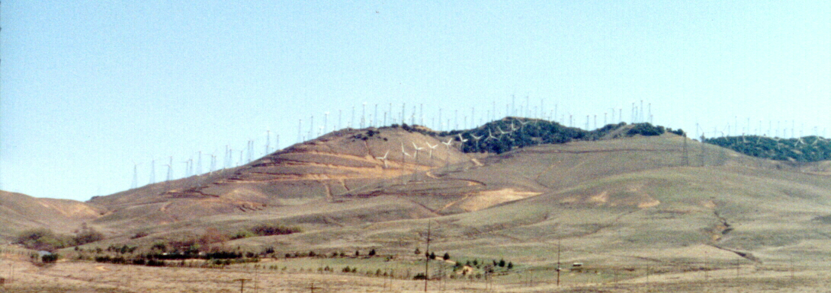
Tehachapi Pass, California, 2001
Bird Blender

Slide 31
????Megawatt????
A “Megawatt of “Installed Capacity” of Wind Generated Electricity powers about 270 homes
2019 US Wind Generation = 110,000 MW =
about 30 million homes

Slide 32
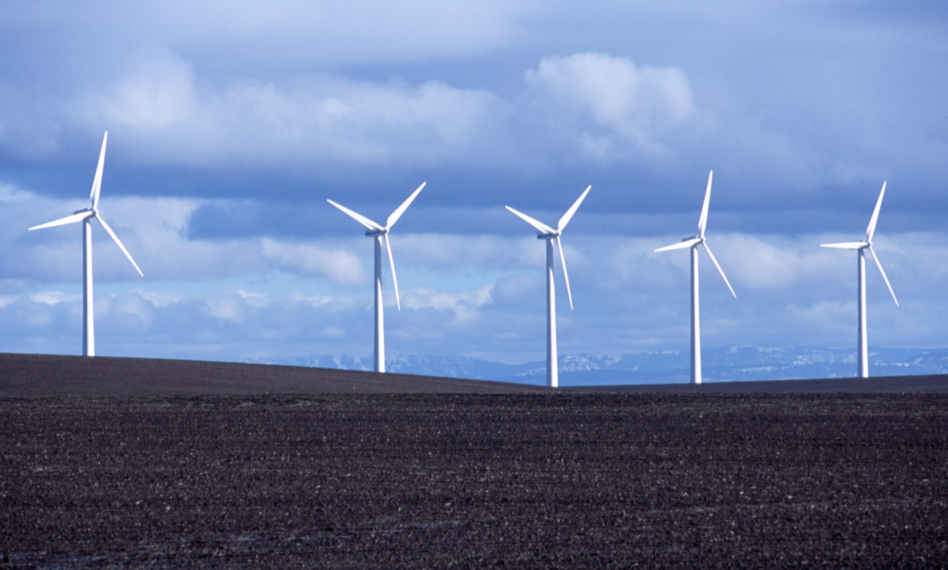
Everything about Wind Energy in the US Installed Capacity map by year and state

Slide 33
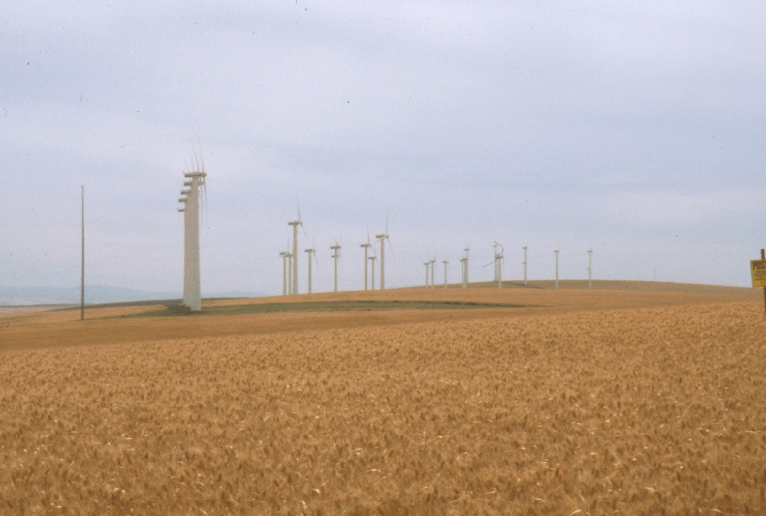
Vansycle Ridge Wind Farm; Northern Oregon

Slide 34
Current Wind Power
2020 output = Almost 10% of US needs
Installed capacity increases:
5% in 2010
31% in 2011
60% in 2012
20% in 2013
9% in 2014
16% in 2015
13% in 2016
15% in 2017
8% in 2018

Slide 35
Potential Wind E. in NW
--STATE--
Oregon
Washington
Idaho
Montana
--MEGAWATTS--
4,900
3,700
8,300
116,000

Slide 36
Oregon’s Power Future
Why not Oregon? Potential to be 100% renewable:
Efficiency (Negawatts)—Always do this first
Geothermal: My favorite new energy
Hydro
Wind
Waves
Solar
Batteries
We’re cooler than you, let’s prove it.

Slide 37
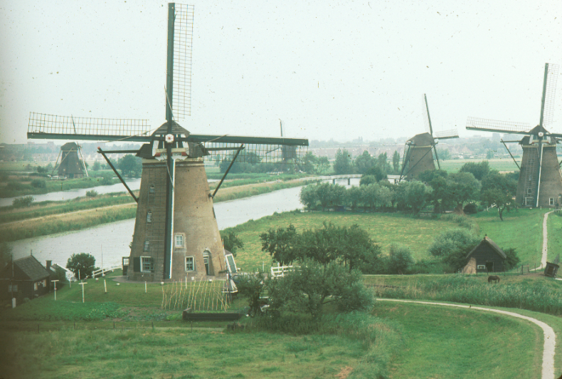

Slide 38
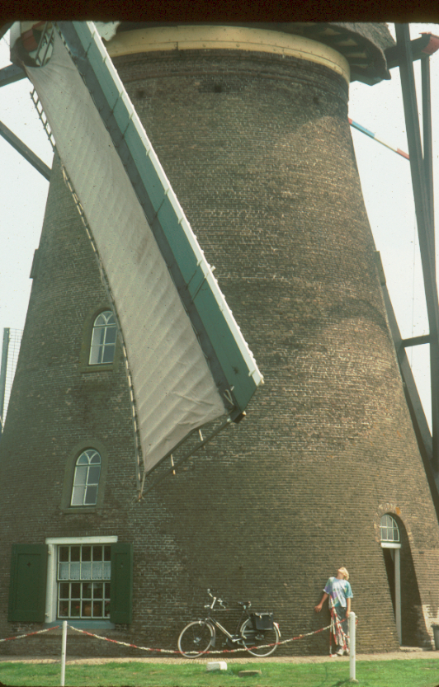

Slide 45
Global Wind Energy 2012* The big 5 *(In Gigawatts)

Slide 46
U.S. vs World Wind Power 2012* *(In Gigawatts)

Slide 47
Global Wind Energy (Gigawatts) 2013--The Big Five

